Slide 1

IISC Bengaluru CCE 2022
Computing for Artificial Intelligence and Machine Learning
Project - Transportation Choice Prediction for office employees using Machine Learning
Submitted by
Mr. Karan Rajput
Mr. Prashant Kumar Lanka
Mr. Ravikumar

Slide 2
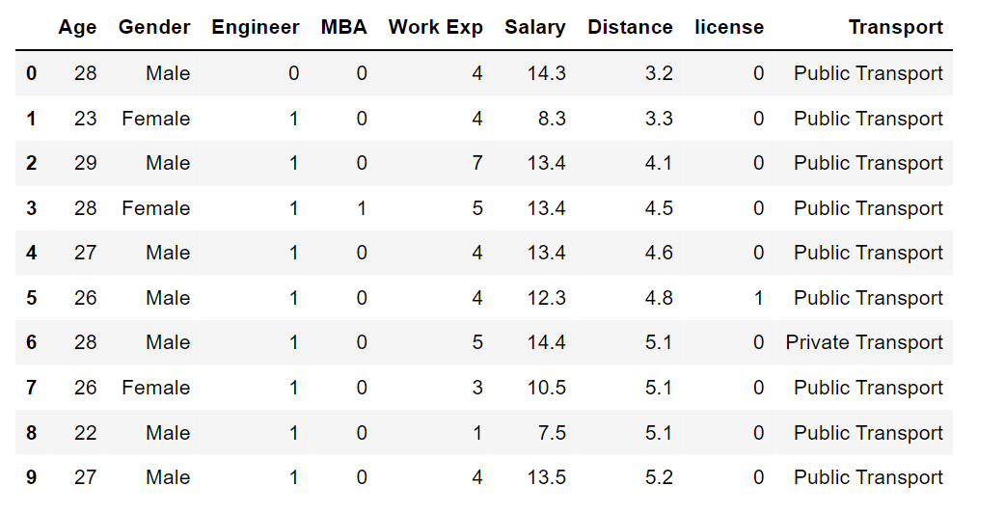
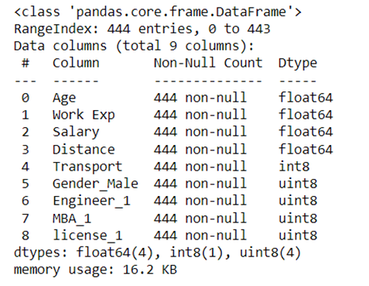
Project Summary
Objective :
Using different machine learning models to predict whether an employee will choose public transport or private transport basis on the features like Age, Gender, Education, Salary & license possession
Shape & Info of the dataset:
number of rows: 444
number of columns: 9

Slide 3
Work Flow -
Load Dataset
Understanding Features
Univariate Analysis
Scaling Data
Split – Test & Train
Evaluating Different Machine Learning Model
Choosing Best Model
Looking for Null Value
Multivariate Analysis

Slide 4
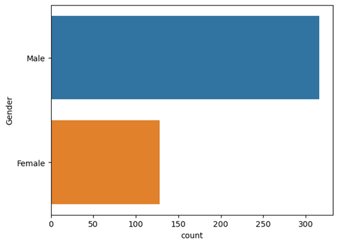
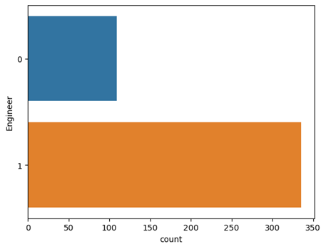
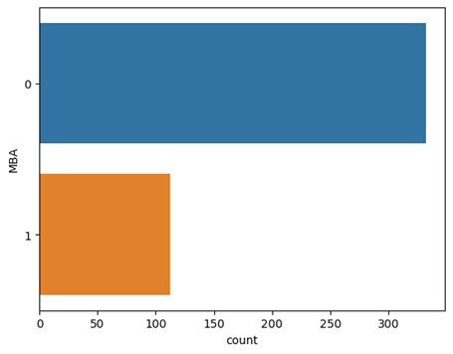
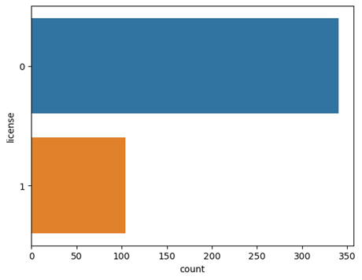
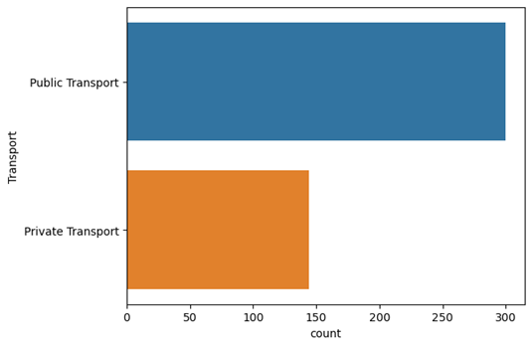
Univariate Analysis:

Slide 5
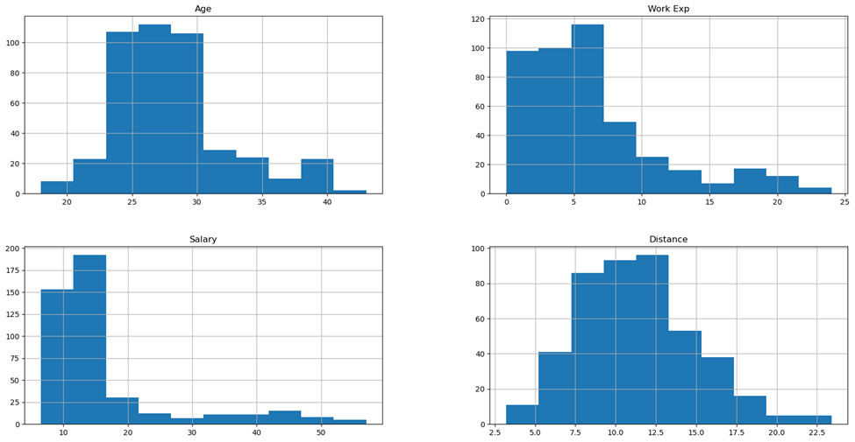
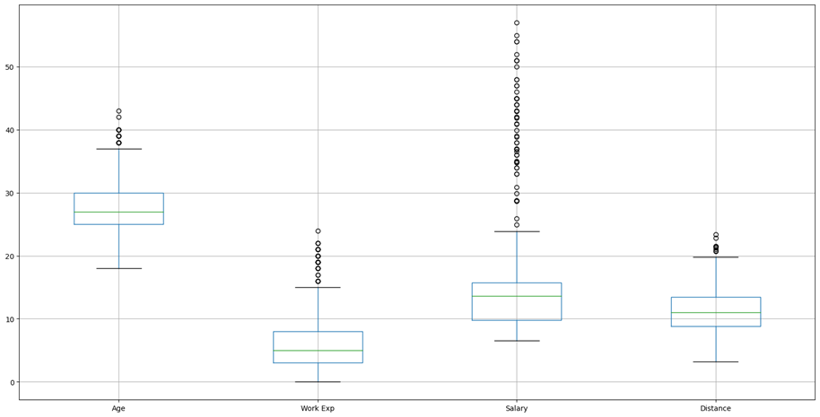
Univariate Analysis:

Slide 6
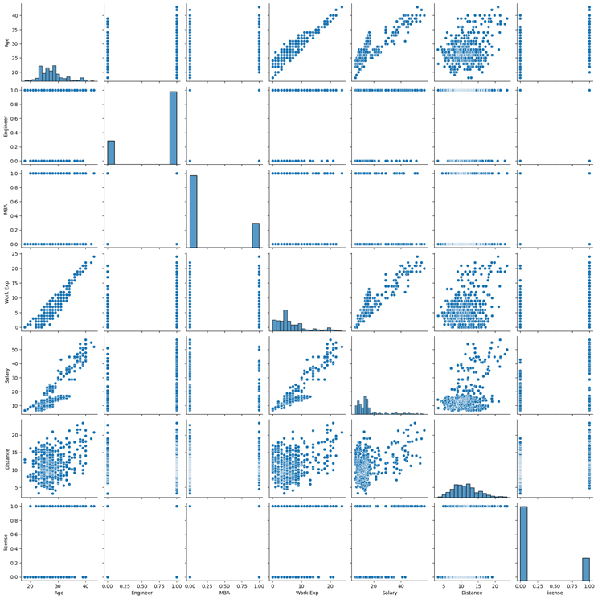
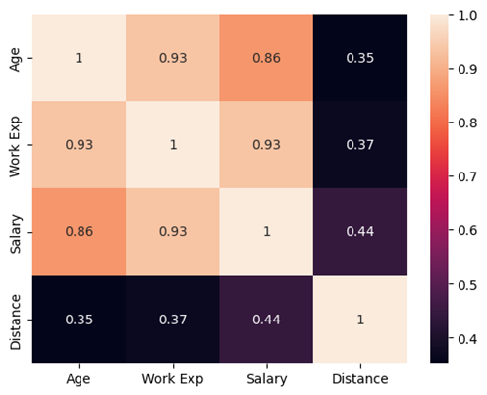
Multivariate Analysis
It is found that Age & Work Ex. And Age and Salary are highly correlated. There is a poor or less correlation between distance and other feature types.

Slide 7
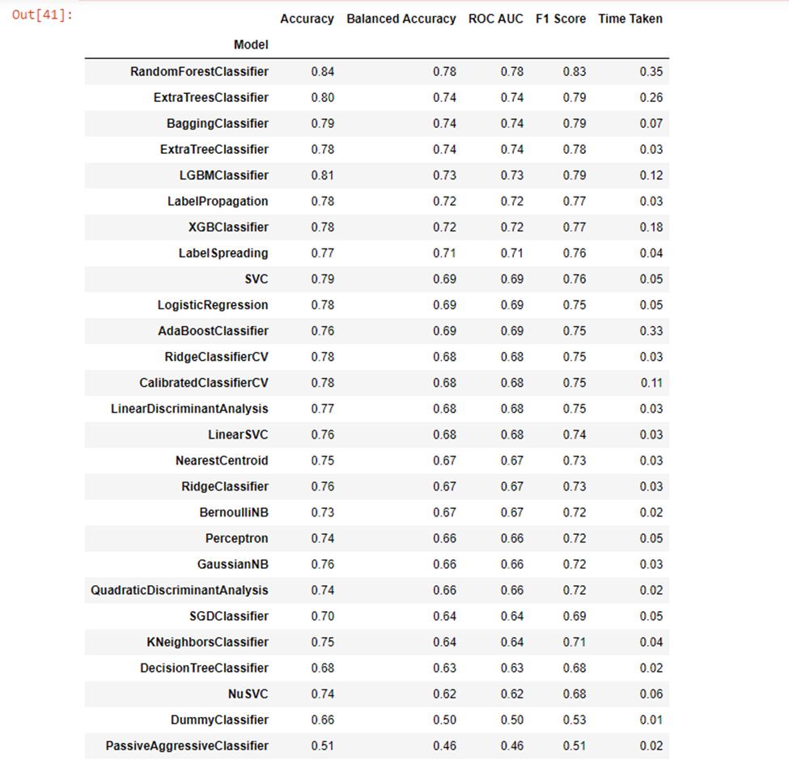
Machine Learning Model
Machine Learning Models are evaluated and compared using Lazy predict code. This checks for the 26 different machine learning model and gives comparable data for it.

Slide 8
Conclusion -
The bivariate analysis indicate that based on gender and availability of license, both males and females having license prefer private transport. Therefore, apart from gender, license is another deciding factor in determining the use the private or public transport.
Based on the accuracy of the various models, it can be concluded that the Random Forest classifier model is the best model for the given dataset as this model gives the highest accuracy of 84%.

